Slide 1
Survey Results – deep dive: business model innovation & digital maturity
July 2025

Slide 2
S2030 Survey 2025
About this survey:
  Benchmarking exercise: critical business intelligence about Members’ current performance and ambitions in the areas of BMI and digital maturity
    Monitor progress over time: bilateral Member survey on strategic priorities
    Inform decision making by advisory and governance bodies – context of transformation
    Identify needs, constraints and capacity gaps
About this presentation:
  Complements summary report (but offers more detail)
  Further support: bilateral meetings (optional, for further clarification)
  Internal use only

Slide 3
Table of contents:
Membership profile(s)
Current Business Models
Future outlook
Digital Maturity
In conclusion

Slide 4

98% Response Rate
Thank you!

Slide 5
Membership profiles
Associations, statutes (public/private), staff and revenue sizes

Slide 6
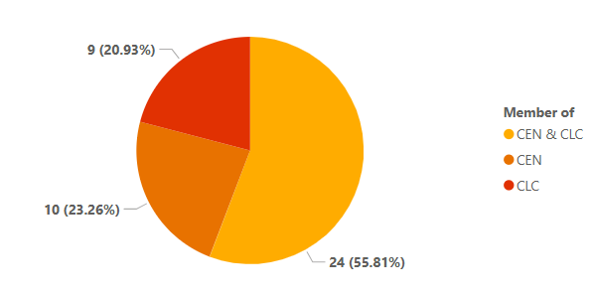
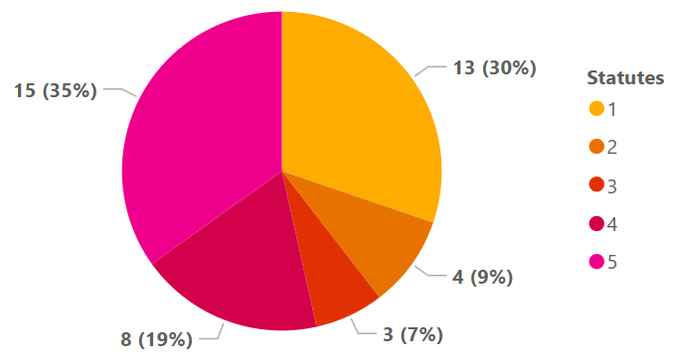
Response sample
Number of Organizations per Association
Number of Organizations per Statute
The 1 to 5 scale defines the ownership structure of the organization, where 1 is completely public, 3 is balanced public-private, and 5 is completely private

Slide 7
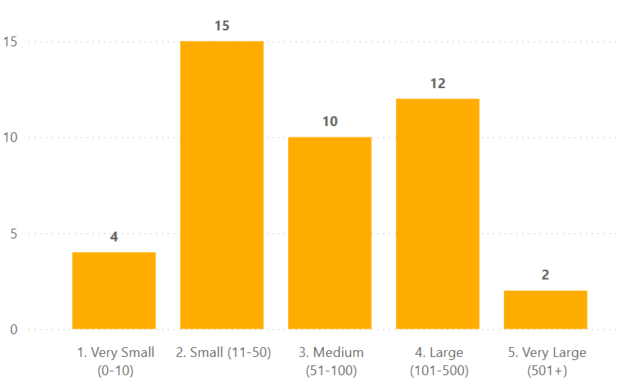
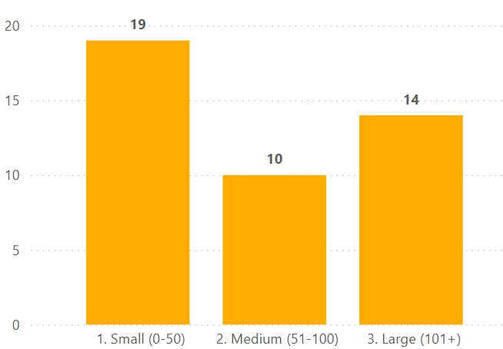
Membership by organization size
Distribution of Organizations by staff size

Slide 8
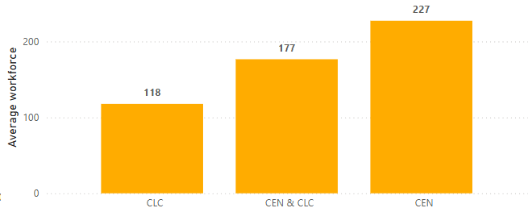
Workforce trends
Average workforce by Association

Slide 9
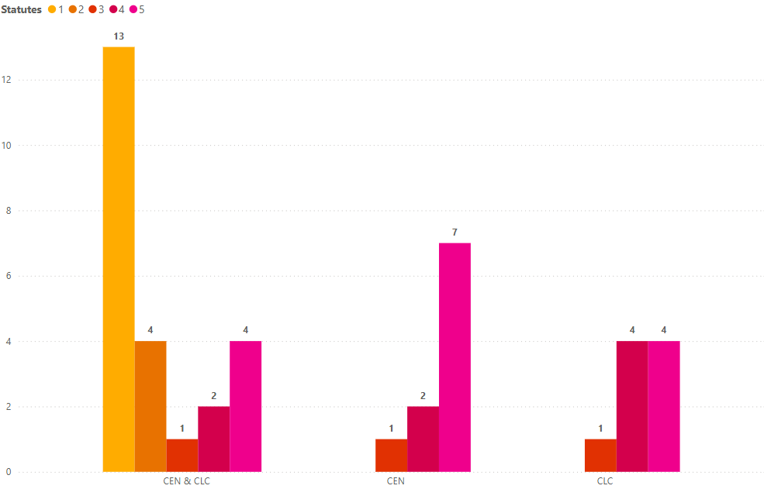
Distribution of Statutes per Association
The 1 to 5 scale defines the ownership structure of the organization, where 1 is completely public, 3 is balanced public-private, and 5 is completely private

Slide 10
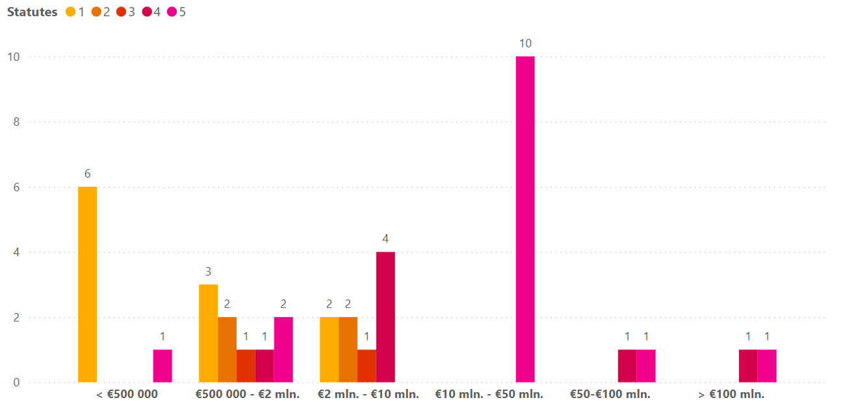
Membership by revenue & statutes
The 1 to 5 scale defines the ownership structure of the organization, where 1 is completely public, 3 is balanced public-private, and 5 is completely private

Slide 11
From deep dive to insights: Membership
Findings
98% response rate
Membership
43% of the Membership qualify as micro (4, <10 staff) or small (15, <50) enterprises
Less than 40% of the Membership (17) is entirely or primarily public
Revenue
70% make less then Eur. 10 Mln. in annual revenue;
37% make less then Eur. 2 Mln.
Insights
Topic lives
Diversity prevails
Capacity and resource constraints = real
… but the majority is
    Medium/L
    ~private
    > 2 Mln. Euro
At an association level, the capacity to transform is there.

Slide 12
Current Business Models
Service and Connectivity levels
Current BMs

Slide 13
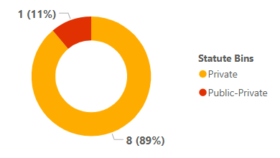
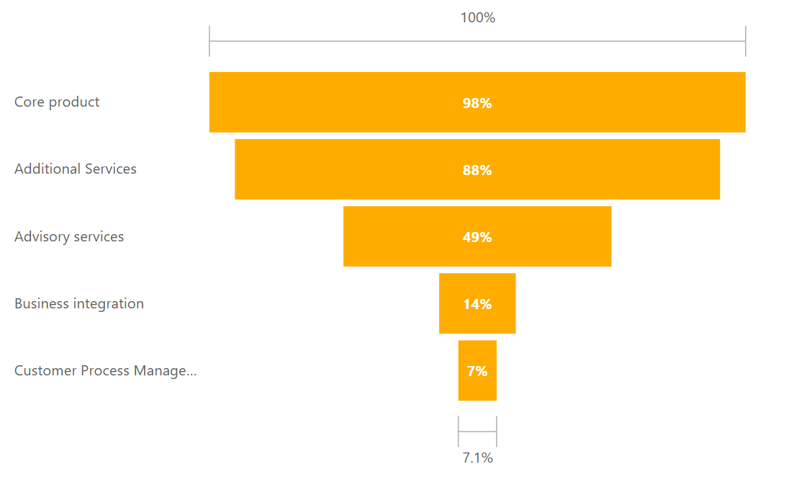
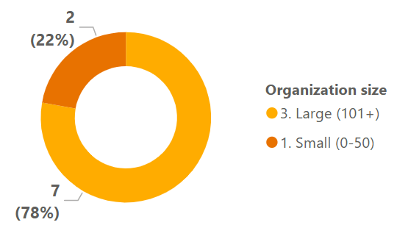
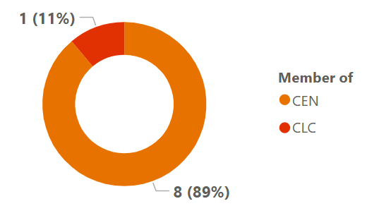
Types of products and services currently offered
Distribution by types of products and services offered
9 organizations

Slide 14
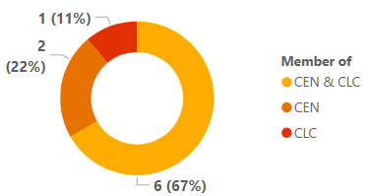
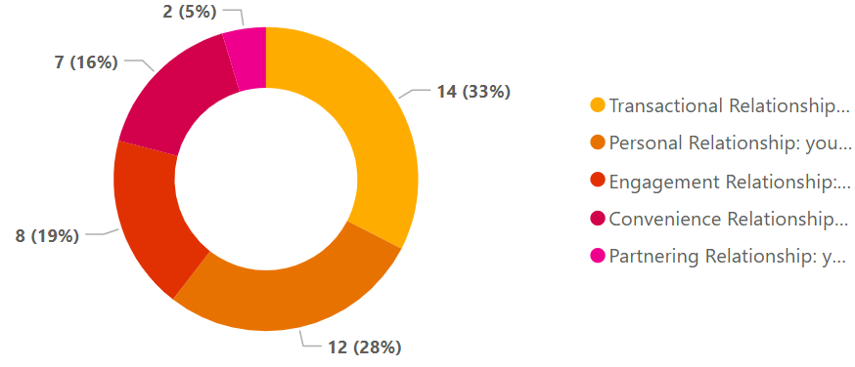
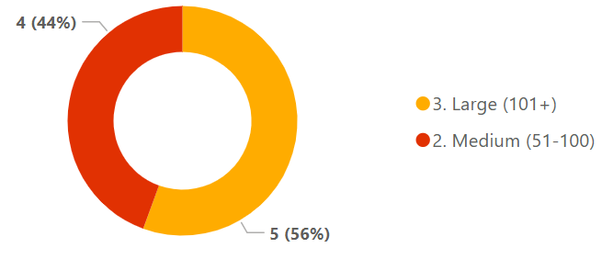
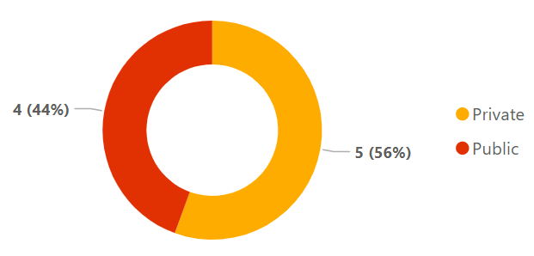
Most advanced connectivity-level with a customer
Distribution by most advanced connectivity-level with a customer

Slide 15
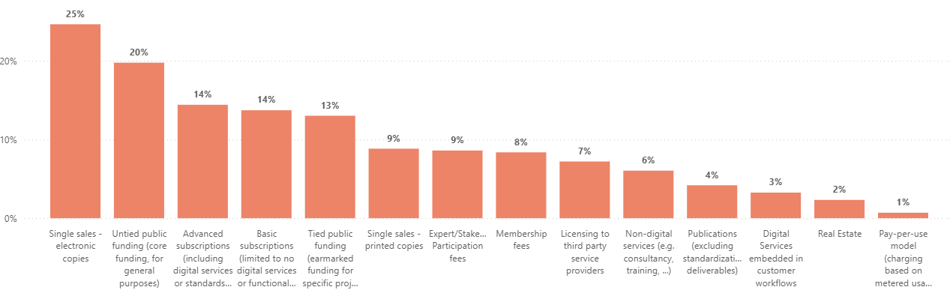
Current business models (% revenue)
Average of % contribution to revenue per BM

Slide 16
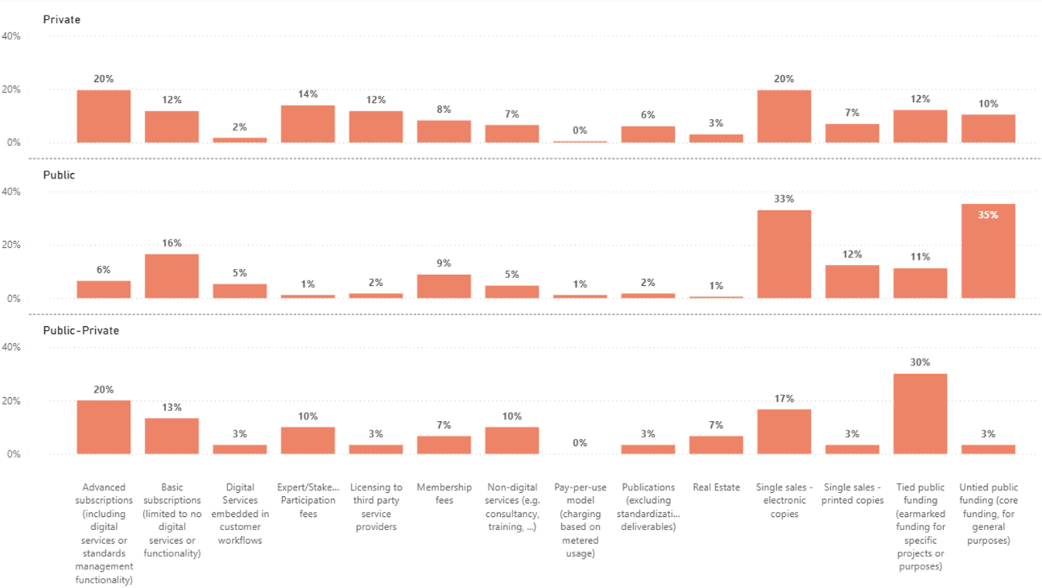
Current business models (% revenue)
Disparity of reliance on specific BMs depending on the Statute of the Org.

Slide 17
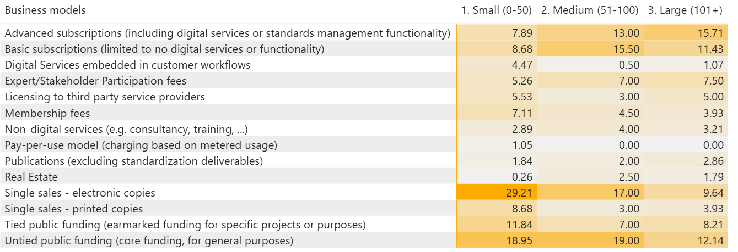
Relationship between size of organization and types of business models

Slide 18
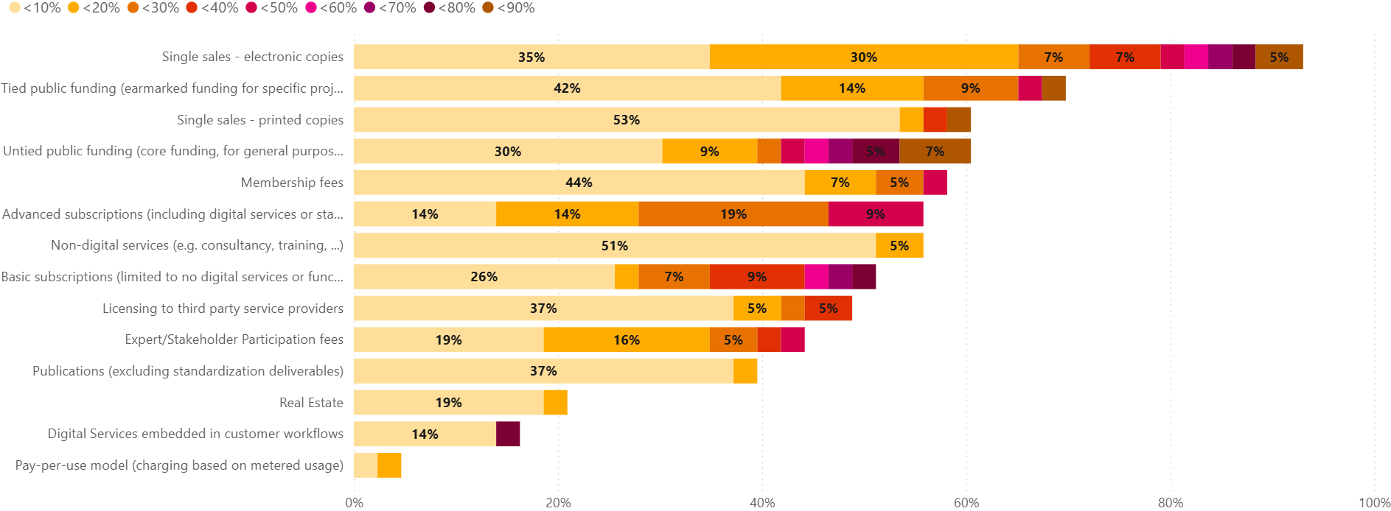
Current business models (% revenue)

Slide 19
From deep dive to insights: BMs
Findings
On average:
Single sales account for 1/3rd of Members’ revenues
Subscriptions are on the rise
Integrated digital services still marginal in terms of revenue contribution
Individually
Problematic dependencies on single sales (& public funding) remain
Narrow revenue bases: 22 Organizations have at least one business model contributing to more than 40% of their total revenue
Size matters
Smaller Members (<50 in staff) tend to rely more on single sales
Medium and large Members rely more on subscriptions (basic > advanced respectively)
Insights
Findings confirm FiMO results & working assumptions
  Single Sales = still king
  Problematic dependencies remain (Single sales & public funding)
    Small & Public = most at risk
  ½ Membership potentially exposed (narrow revenue bases)
Overall, current BMIs are not sustainable

Slide 20
Future outlook
Confidence
Trends
Ambitions

Slide 21
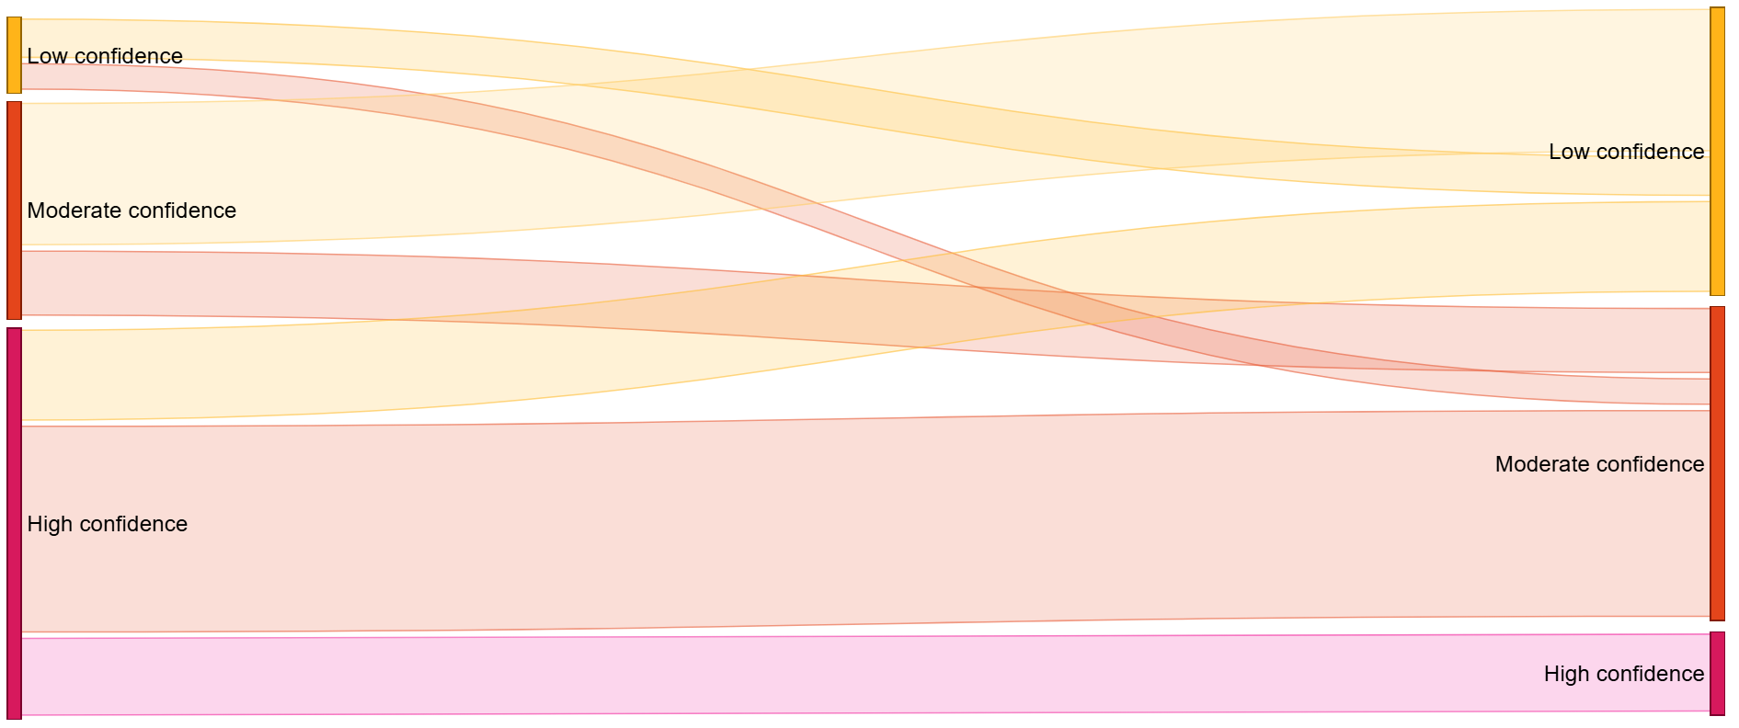
Level of confidence in primary business model(s)
Current Confidence Confidence in 5 years
7%
42%
33%
47%
60%
12%

Slide 22
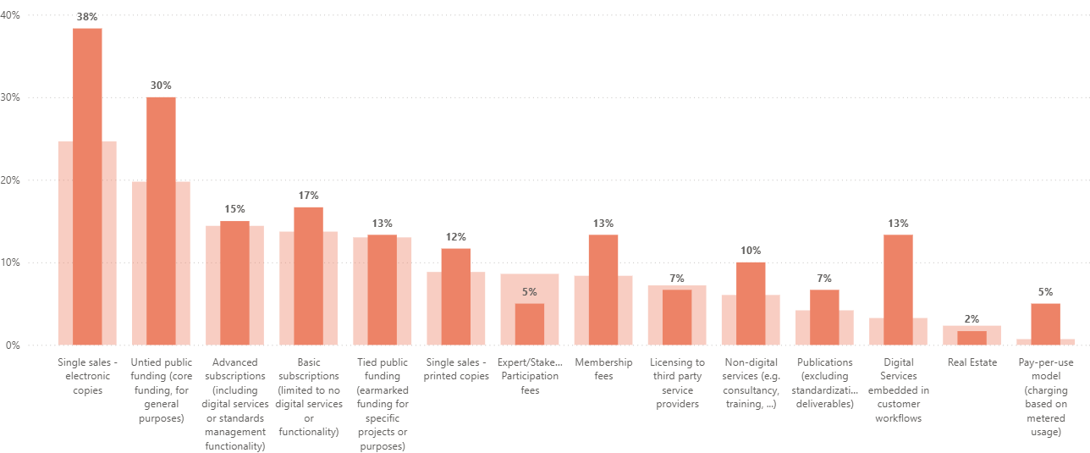
High to Low confidence – Primary BMs
Average of % contribution to revenue per BM for the (6) Members shifting from high to low confidence over the next 5 years

Slide 23
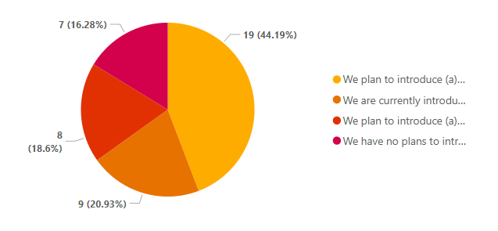
Introducing new business models
65% of Members are currently or planning in the next 2 years to introduce new BMs
(over 80% in 5 years)
We plan to introduce (a) new business model(s) in the next 2 years
We are currently introducing (a) new business model(s)
We plan to introduce (a) new business model(s) in the next 5 years
We have no plans to introduce (a) new business model(s) in the foreseeable future

Slide 24
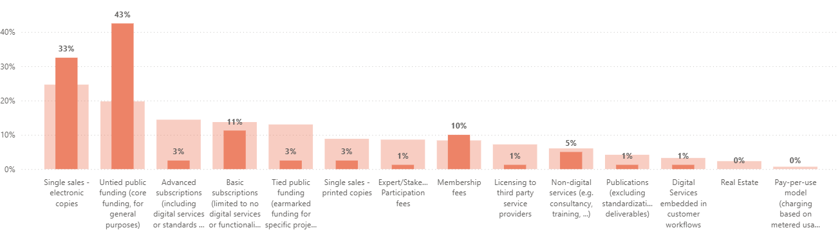
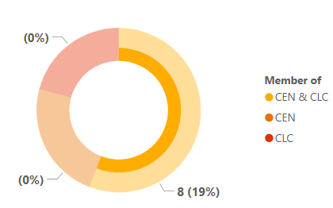
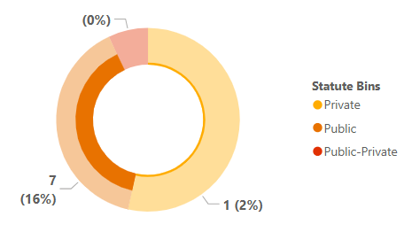
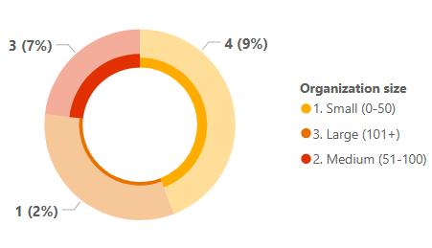
Members with no plans to introduce (a) new business model(s) in the next 5 years
Average of % contribution to revenue per BM for (8) Members with no plans to introduce (a) new BM(s) in the next 5 years

Slide 25
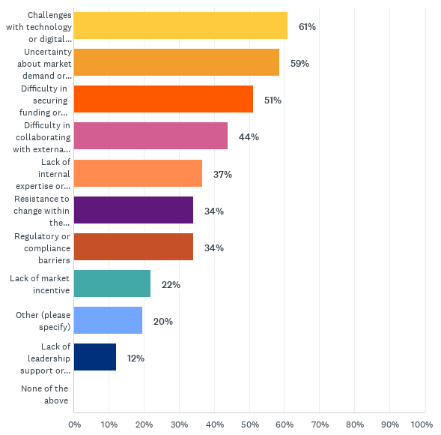
Key challenges when implementing BMI

Slide 26
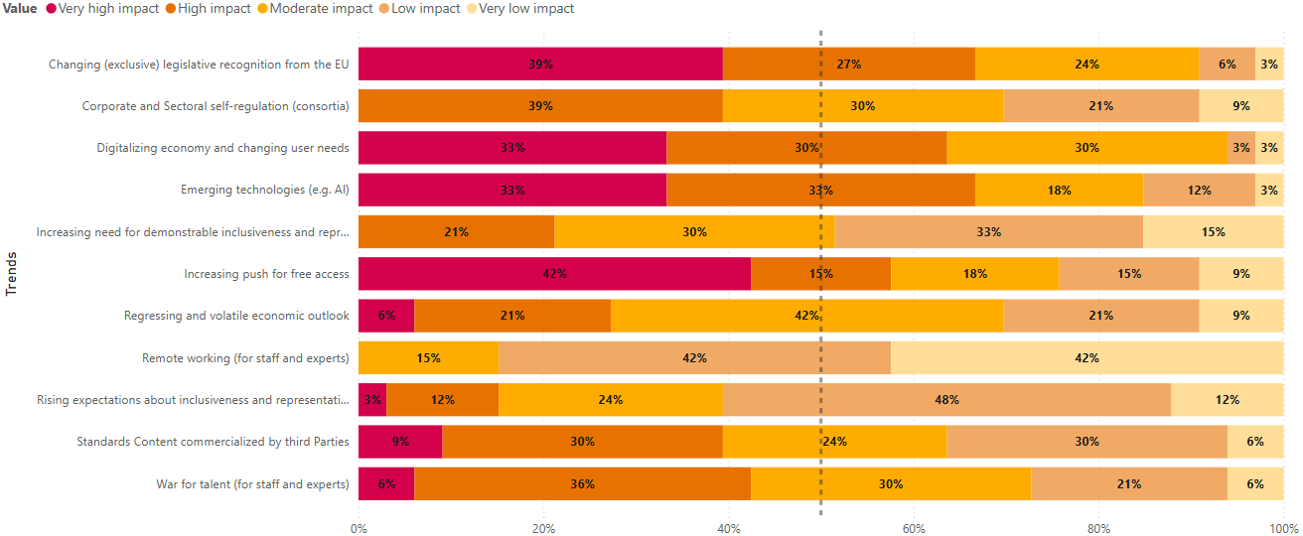
Trends and perceived impact on business
1
3
2
4
5

Slide 27
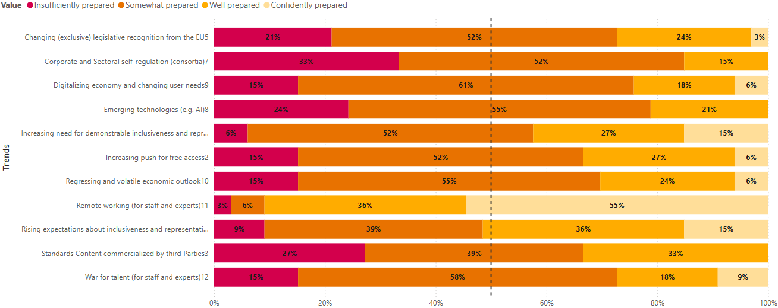
Level of preparedness to trends
1
4
3
2
5

Slide 28
From deep dive to insights: outlook
Findings
Confidence:
Only 1 in 10 have high confidence in the future viability of their primary BMs (9/10 have low to moderate confidence in 5y time)
Members who predominantly rely on single sales (electronic) show steepest decline in confidence (high to low);
High ambitions:
65% of the membership is or plans to innovate (in 2 years)
Members with no BMI ambitions predominantly public with heavy reliance on untied public funding
Key challenges to BMI indicate a pressing need for:
Enhancing digital and technical capacity,
Improved understanding of market trends and customer needs
Resolving/bypassing resource constraints: financial and HR wise
Insights
Members realize they need new BMs
Members want & plan to innovate their BMs
But BMI hinges on three limitations
  Understanding user needs
  Financial and human resource constraints
  Digital & technological capacity

Slide 29
Digital Maturity

Slide 30
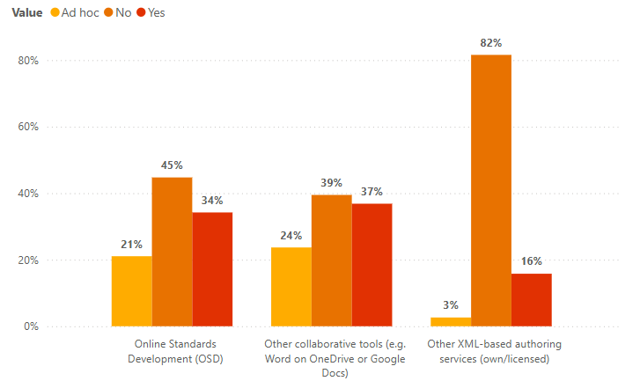
Tools used for drafting national Standards
Majority do not use OSD or XML, but do use other collaborative tools

Slide 31
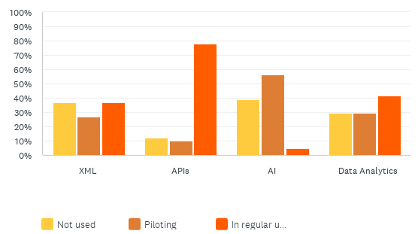
Embedding technologies in business practices

Slide 32
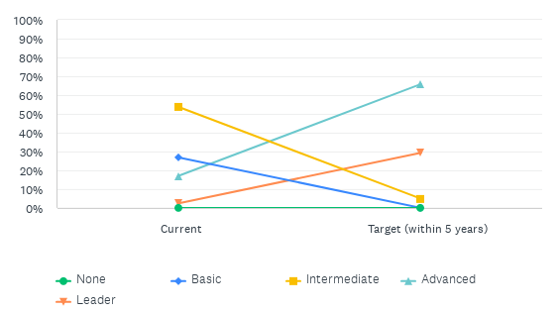
Current and future (ambition) level in relation to core standardization processes
Scale guide:
None - Lack structure and automation
Basic - Basic structure but lack automation
Intermediate - Structured with basic automation
Advanced - Well-structured with robust automation
Leader - Well-structured with robust automation and experimenting with new technologies to improve (AI)

Slide 33
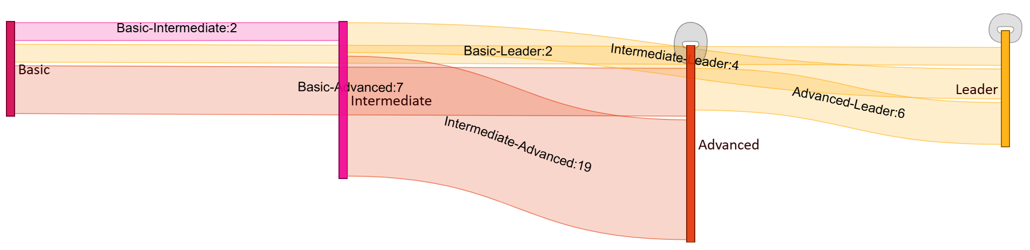
Current and future (ambition) level in relation to core standardization processes
2
1

Slide 34
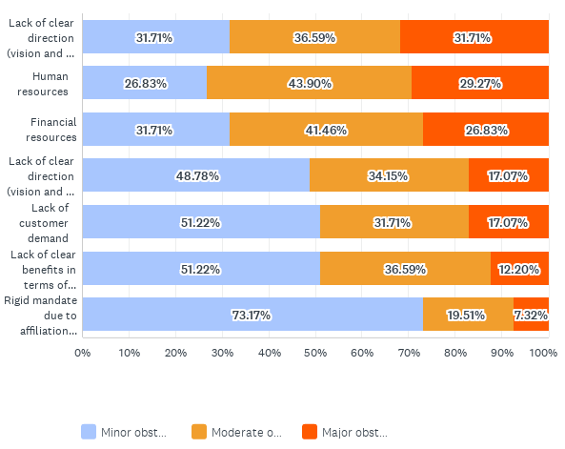
Main factors that limit your target maturity level
CEN & CENELEC
ISO & IEC

Slide 35
From deep dive to insights: digital
Findings
(Very) high ambitions:
Over 90% of the Membership wants to be either
Advanced - Well-structured with robust automation: from 8 to 28 Advanced; OR
Leader - Well-structured with robust automation and experimenting with new technologies to improve (AI): from 1 to 13 leaders in 5y.
(1 intermediate)
… but barriers in the way:
Vision, sense of direction and who does what
Resource constraints: financial and staff wise
Customer/market demand uncertain
Insights
As for BMI: ambition = there
But success will hinge on:
Resources
Vision
Customer intimacy

Slide 36
In conclusion
Members still rely predominantly on single sales (and public funding)
Members realize they need new business models and want to change.
Members need help with:
    Resources (Fin & HR)
    Digital transformation & Tech. innovation
    Direction – Transformation strategy
    Members don’t know their customer
The joint capacity to tackle these individual challenges as a community is present

Slide 37
Thank you
Contact: Brecht LEIN, blein@cencenelec.eu

